Slide 1
Document Object Model

Slide 2
Objective
To learn
  Motivation
  The structure of HTML document
  Properties and methods of Node object
  Modify the structure of document
  Event handling
Jackson, Web Technologies: A Computer Science Perspective, © 2007 Prentice-Hall, Inc. All rights reserved. 0-13-185603-0

Slide 3
Outcome
Students will be able to
  Modify the structure of the document
  Understand event handling in DOM
Jackson, Web Technologies: A Computer Science Perspective, © 2007 Prentice-Hall, Inc. All rights reserved. 0-13-185603-0

Slide 4
Context
HTML and CSS were helpful in designing non-interactive website
However, Javascript is useful to create interactive website
DOM is used to interact with HTML document
Jackson, Web Technologies: A Computer Science Perspective, © 2007 Prentice-Hall, Inc. All rights reserved. 0-13-185603-0

Slide 5
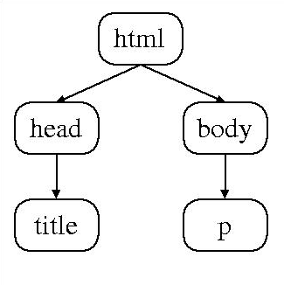
Document Tree
Recall that HTML document elements form a tree structure, e.g.,
DOM allows scripts to access and modify the document tree
Jackson, Web Technologies: A Computer Science Perspective, © 2007 Prentice-Hall, Inc. All rights reserved. 0-13-185603-0

Slide 6
Properties and Methods of Node Object
There are many types of nodes in the DOM document tree, representing elements, text, comments, the document type declaration, etc.
Every Object in the DOM document tree has properties and methods defined by the Node host object
Jackson, Web Technologies: A Computer Science Perspective, © 2007 Prentice-Hall, Inc. All rights reserved. 0-13-185603-0

Slide 7
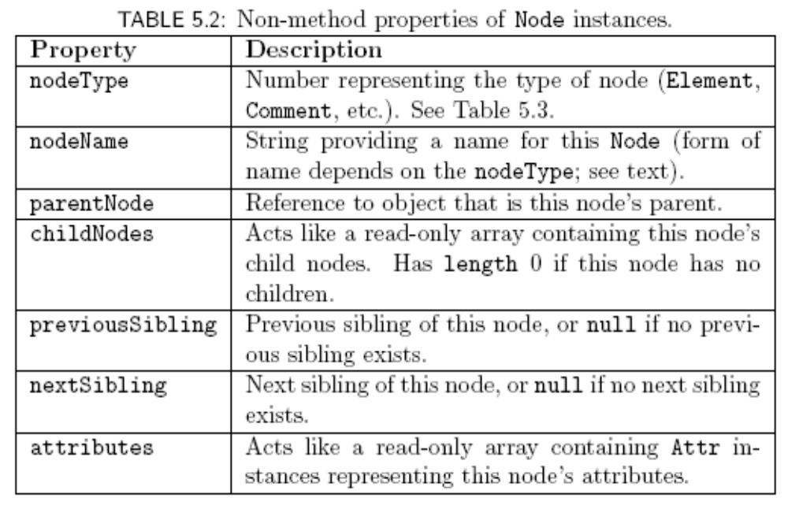
Properties and Methods of Node Object
Jackson, Web Technologies: A Computer Science Perspective, © 2007 Prentice-Hall, Inc. All rights reserved. 0-13-185603-0

Slide 8
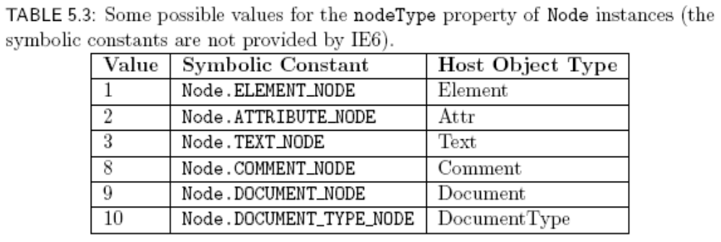
Type of Nodes
Jackson, Web Technologies: A Computer Science Perspective, © 2007 Prentice-Hall, Inc. All rights reserved. 0-13-185603-0

Slide 9
Properties and Methods of Node Object
Jackson, Web Technologies: A Computer Science Perspective, © 2007 Prentice-Hall, Inc. All rights reserved. 0-13-185603-0

Slide 10
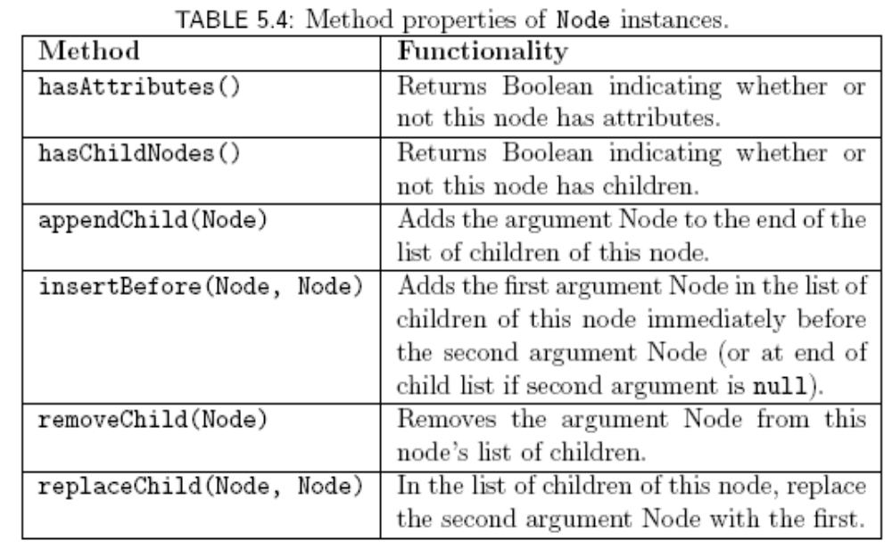
Properties and Methods of Node Object
Jackson, Web Technologies: A Computer Science Perspective, © 2007 Prentice-Hall, Inc. All rights reserved. 0-13-185603-0

Slide 11
Document Tree: document
The document object is also considered a Node object
Technically, document is the root Node of the DOM tree
  html Element object is a child of document
  Other children may also include document type declaration, comments, text elements (white space)
Guy-Vincent Jourdan :: CSI 3140 :: based on Jeffrey C. Jackson’s slides

Slide 12
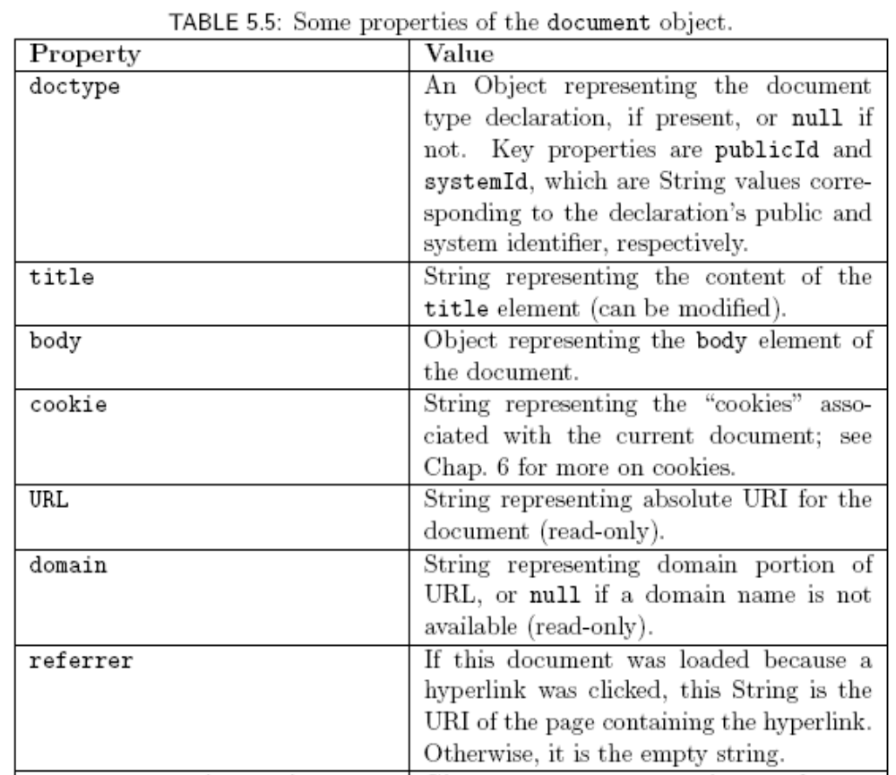
Document Tree: document
Guy-Vincent Jourdan :: CSI 3140 :: based on Jeffrey C. Jackson’s slides

Slide 13
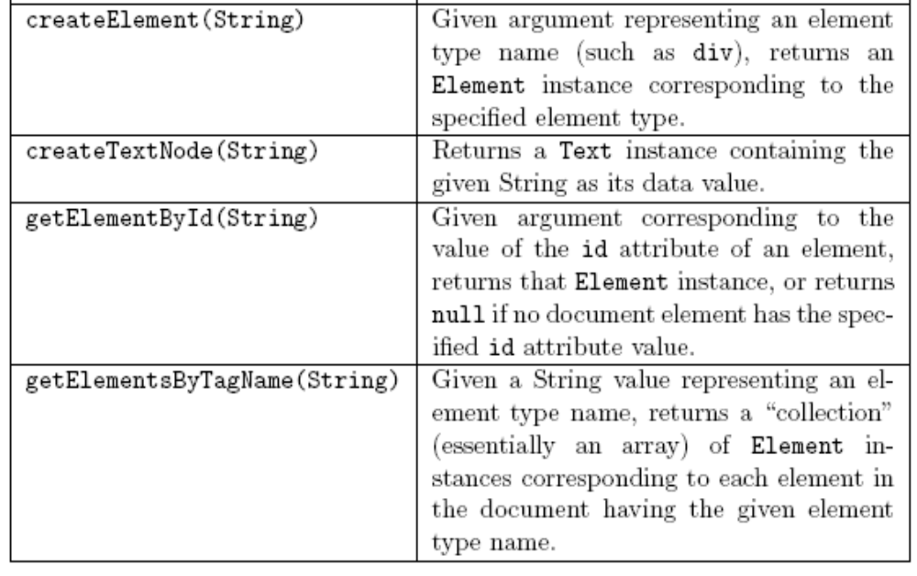
Document Tree: document
Guy-Vincent Jourdan :: CSI 3140 :: based on Jeffrey C. Jackson’s slides

Slide 14
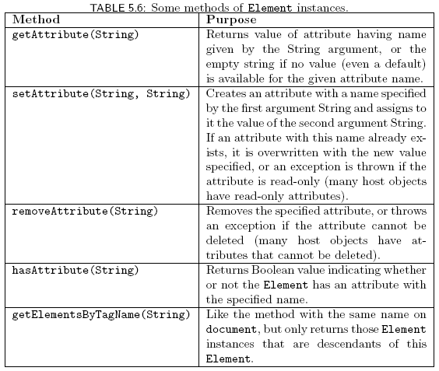
Document Tree: Element Nodes
Guy-Vincent Jourdan :: CSI 3140 :: based on Jeffrey C. Jackson’s slides

Slide 15
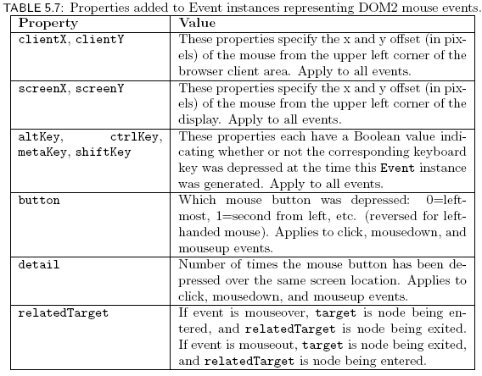
DOM Event Handling:
Mouse Events
Guy-Vincent Jourdan :: CSI 3140 :: based on Jeffrey C. Jackson’s slides

Slide 16
Document Tree: Text Nodes
data property represents character data of a Text node
  Modifying the property modifies the corresponding text in the browser
By default, the DOM tree may contain sibling Text nodes
  Example: &copy; 2007 might be split into two Text nodes, one with copyright character
  Call normalize() method on an ancestor node to prevent this
Guy-Vincent Jourdan :: CSI 3140 :: based on Jeffrey C. Jackson’s slides

Slide 17
Document Tree: Adding Nodes
<body onload="makeCollapsible('collapse1');">
<ol id="collapse1">
<li>First element of ordered list.</li>
<li>Second element.</li>
<li>Third element.</li>
</ol>
<p>
Paragraph following the list (does not collapse).
</p>
</body>
Body of original HTML document:
Guy-Vincent Jourdan :: CSI 3140 :: based on Jeffrey C. Jackson’s slides

Slide 18
Document Tree: Text Nodes
data property represents character data of a Text node
  Modifying the property modifies the corresponding text in the browser
By default, the DOM tree may contain sibling Text nodes
  Example: &copy; 2007 might be split into two Text nodes, one with copyright character
  Call normalize() method on an ancestor node to prevent this
Guy-Vincent Jourdan :: CSI 3140 :: based on Jeffrey C. Jackson’s slides

Slide 19
Document Tree: Adding Nodes
<body onload="makeCollapsible('collapse1');">
<ol id="collapse1">
<li>First element of ordered list.</li>
<li>Second element.</li>
<li>Third element.</li>
</ol>
<p>
Paragraph following the list (does not collapse).
</p>
</body>
Body of original HTML document:
Guy-Vincent Jourdan :: CSI 3140 :: based on Jeffrey C. Jackson’s slides

Slide 20
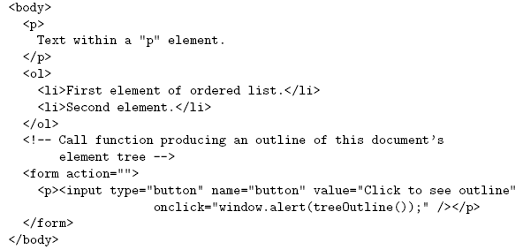
Document Tree: Node
Example HTML document
Function we will write that will
use Node methods and properties
to produce string representing
Element tree
Jackson, Web Technologies: A Computer Science Perspective, © 2007 Prentice-Hall, Inc. All rights reserved. 0-13-185603-0

Slide 21
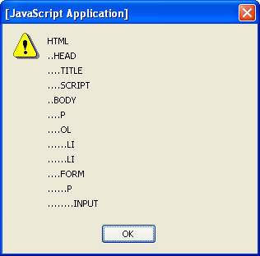
Document Tree: Node
String produced by TreeOutline():
Jackson, Web Technologies: A Computer Science Perspective, © 2007 Prentice-Hall, Inc. All rights reserved. 0-13-185603-0

Slide 22
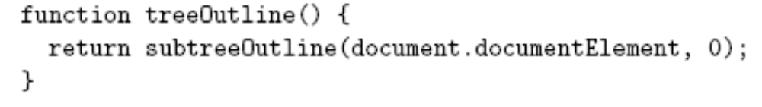
Document Tree: Node
Example: “walking” the tree of an HTML document
  Reference to html element is contained in documentElement property of document object
  Use Node-defined methods to recursively create an outline of nodeName’s:
Depth in tree
Jackson, Web Technologies: A Computer Science Perspective, © 2007 Prentice-Hall, Inc. All rights reserved. 0-13-185603-0

Slide 23
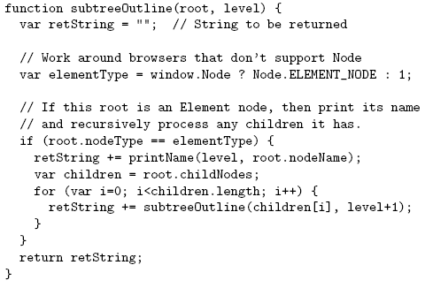
Document Tree: Node
Jackson, Web Technologies: A Computer Science Perspective, © 2007 Prentice-Hall, Inc. All rights reserved. 0-13-185603-0

Slide 24
Contd…
function printname(level, thisName){
var retString=“”;
for(var i=0; i<level; i++){
retString += “..”;
}
retString += thisName+”\n”;
Return retString;
}

Slide 25
Document Tree: Node
Contains nodeType value representing Element
Jackson, Web Technologies: A Computer Science Perspective, © 2007 Prentice-Hall, Inc. All rights reserved. 0-13-185603-0

Slide 26
Document Tree: Adding Nodes
Body of original HTML document:
<body onload="makeCollapsible('collapse1');">
<ol id="collapse1">
<li>First element of ordered list.</li>
<li>Second element.</li>
<li>Third element.</li>
</ol>
<p>
Paragraph following the list (does not collapse).
</p>
</body>
Jackson, Web Technologies: A Computer Science Perspective, © 2007 Prentice-Hall, Inc. All rights reserved. 0-13-185603-0

Slide 27
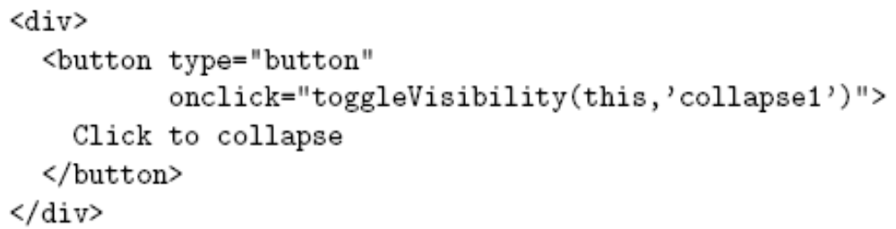
Document Tree: Adding Nodes
Effect of executing makeCollapsible():
<body onload="makeCollapsible('collapse1');">
<ol id="collapse1">
<li>First element of ordered list.</li>
<li>Second element.</li>
<li>Third element.</li>
</ol>
<p>
Paragraph following the list (does not collapse).
</p>
</body>
Added
to DOM
tree:
Jackson, Web Technologies: A Computer Science Perspective, © 2007 Prentice-Hall, Inc. All rights reserved. 0-13-185603-0

Slide 28
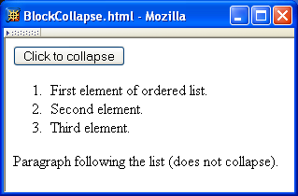
Document Tree: Adding Nodes
Added element
is displayed as if
it was part of
the HTML source
document
Jackson, Web Technologies: A Computer Science Perspective, © 2007 Prentice-Hall, Inc. All rights reserved. 0-13-185603-0

Slide 29
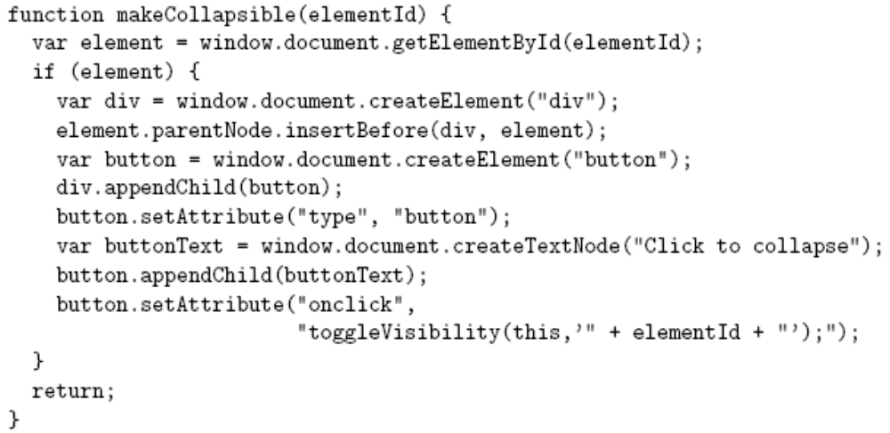
Document Tree: Adding Nodes
Jackson, Web Technologies: A Computer Science Perspective, © 2007 Prentice-Hall, Inc. All rights reserved. 0-13-185603-0

Slide 30
Document Tree: Adding Nodes
Node
creation
Jackson, Web Technologies: A Computer Science Perspective, © 2007 Prentice-Hall, Inc. All rights reserved. 0-13-185603-0

Slide 31
Document Tree: Adding Nodes
Node
addition to DOM
tree (rec. doing
this immediately
after creation).
Jackson, Web Technologies: A Computer Science Perspective, © 2007 Prentice-Hall, Inc. All rights reserved. 0-13-185603-0

Slide 32
Document Tree: Adding Nodes
Attribute
addition
Jackson, Web Technologies: A Computer Science Perspective, © 2007 Prentice-Hall, Inc. All rights reserved. 0-13-185603-0

Slide 33
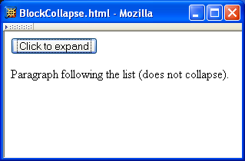
Document Tree: Adding Nodes
Before clicking button:
After clicking button:
Jackson, Web Technologies: A Computer Science Perspective, © 2007 Prentice-Hall, Inc. All rights reserved. 0-13-185603-0

Slide 34
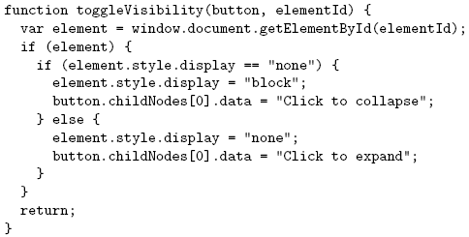
Document Tree: Adding Nodes
Jackson, Web Technologies: A Computer Science Perspective, © 2007 Prentice-Hall, Inc. All rights reserved. 0-13-185603-0

Slide 35
Document Tree: Adding Nodes
Modifying text.
Jackson, Web Technologies: A Computer Science Perspective, © 2007 Prentice-Hall, Inc. All rights reserved. 0-13-185603-0

Slide 36
DOM Event Handling
Note: IE6 has a different event model
Event instance created for each event
Event instance properties:
  type: name of event (click, mouseover, etc.)
  target: Node corresponding to document element that generated the event (e.g., button element for click, img for mouseover). This is the event target.
Jackson, Web Technologies: A Computer Science Perspective, © 2007 Prentice-Hall, Inc. All rights reserved. 0-13-185603-0

Slide 37
DOM Event Handling
JavaScript event listener: function that is called with Event instance when a certain event occurs
An event listener is associated with a target element by calling addEventListener() on the element
Jackson, Web Technologies: A Computer Science Perspective, © 2007 Prentice-Hall, Inc. All rights reserved. 0-13-185603-0

Slide 38
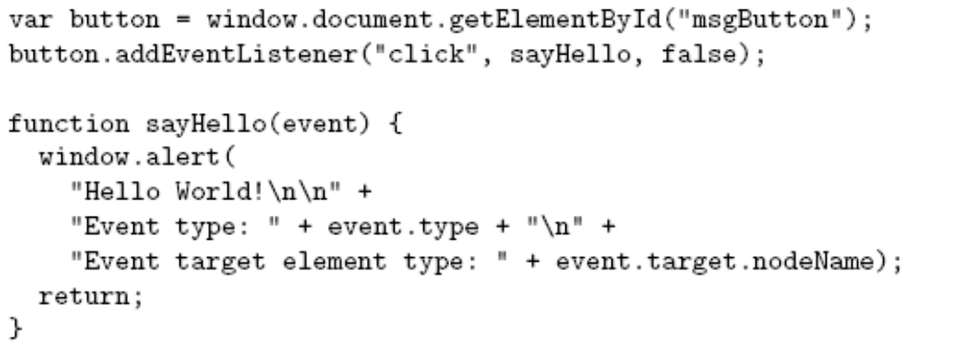
DOM Event Handling
Jackson, Web Technologies: A Computer Science Perspective, © 2007 Prentice-Hall, Inc. All rights reserved. 0-13-185603-0

Slide 39
DOM Event Handling
Event
target
Jackson, Web Technologies: A Computer Science Perspective, © 2007 Prentice-Hall, Inc. All rights reserved. 0-13-185603-0

Slide 40
DOM Event Handling
Event type
Jackson, Web Technologies: A Computer Science Perspective, © 2007 Prentice-Hall, Inc. All rights reserved. 0-13-185603-0

Slide 41
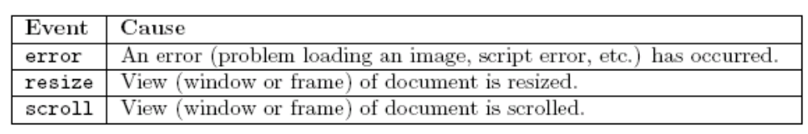
DOM Event Handling
DOM event types:
  All HTML intrinsic events except keypress, keydown, keyup, and dblclick
  Also has some others that are typically targeted at the window object:
Jackson, Web Technologies: A Computer Science Perspective, © 2007 Prentice-Hall, Inc. All rights reserved. 0-13-185603-0

Slide 42
DOM Event Handling
Event handler
Definition
of event
handler
Jackson, Web Technologies: A Computer Science Perspective, © 2007 Prentice-Hall, Inc. All rights reserved. 0-13-185603-0

Slide 43
DOM Event Handling
Event instance
Jackson, Web Technologies: A Computer Science Perspective, © 2007 Prentice-Hall, Inc. All rights reserved. 0-13-185603-0

Slide 44
DOM Event Handling
Normally false
(more later)
Jackson, Web Technologies: A Computer Science Perspective, © 2007 Prentice-Hall, Inc. All rights reserved. 0-13-185603-0

Slide 45
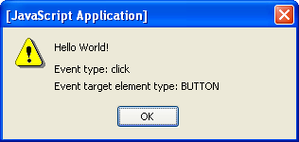
DOM Event Handling
Jackson, Web Technologies: A Computer Science Perspective, © 2007 Prentice-Hall, Inc. All rights reserved. 0-13-185603-0

Slide 46
Simple Questions
How to add a new element in HTML document?
How to find parent of a node?
How to find whether children exists for a given node?
Is it possible to find siblings of a given node?
What are all the objects facilitate to modify the structure of the document?
Jackson, Web Technologies: A Computer Science Perspective, © 2007 Prentice-Hall, Inc. All rights reserved. 0-13-185603-0

Slide 47
References
www.w3schools.com
Deitel and Deitel and Nieto, ―Internet and World Wide Web - How to Program‖, Prentice Hall, 5th Edition, 2011.
Jeffrey C and Jackson, ―Web Technologies A Computer Science Perspective‖, Pearson Education, 2011.
Jackson, Web Technologies: A Computer Science Perspective, © 2007 Prentice-Hall, Inc. All rights reserved. 0-13-185603-0

Slide 48
Summary
Students will be able to
  Modify the structure of the document
  Handle events using DOM
Jackson, Web Technologies: A Computer Science Perspective, © 2007 Prentice-Hall, Inc. All rights reserved. 0-13-185603-0

